Slide 1
HYPOTHESIS TESTING
PRESENTED BY:
MONALISA SINGH
(MSBA, KSU)

Slide 2
What is Hypothesis Testing?
A hypothesis test is a statistical test that is used to determine whether there is enough evidence in a sample of data to infer that a certain condition is true for the entire population.
A hypothesis test examines two opposing hypotheses about a population: the null hypothesis and the alternative hypothesis. The null hypothesis is the statement being tested. Usually the null hypothesis is a statement of "no effect" or "no difference". The alternative hypothesis is the statement you want to be able to conclude is true.

Slide 3
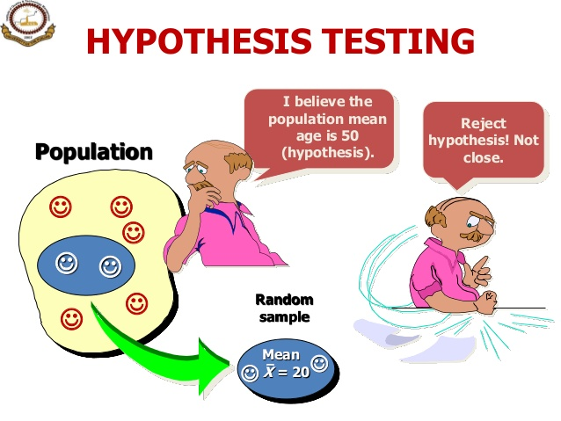
Hypothesis testing for a population
Rejecting the null Hypothesis

Slide 4
EXAMPLE: A case of suspected cheating on an exam is brought in front of the disciplinary committee at a certain university.
There are two opposing claims in this case:
1)The student's claim: I did not cheat on the exam.
2)The instructor's claim: The student did cheat on the exam.
Adhering to the principle "innocent until proven guilty," the committee asks the instructor for evidence to support his claim. The instructor explains that the exam had two versions, and shows the committee members that on three separate exam questions, the student used in his solution numbers that were given in the other version of the exam.
The committee members all agree that it would be extremely unlikely to get evidence like that if the student's claim of not cheating had been true. In other words, the committee members all agree that the instructor brought forward strong enough evidence to reject the student's claim, and conclude that the student did cheat on the exam.

Slide 5
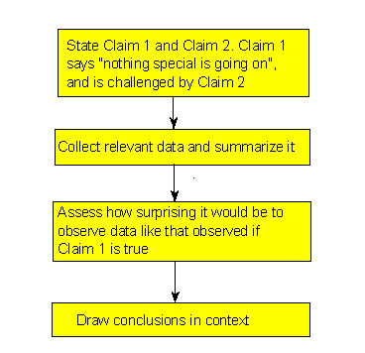

Slide 6
Here is how the process of statistical hypothesis
testing works:
We have two claims about what is going on in the population. Much like the story above, claim 1 is challenged by claim 2.
We choose a sample, collect relevant data and summarize them (i.e. the instructor collecting evidence from the student's exam)
We figure out how likely it is to observe data like the data we got, had claim 1 been true. (i.e. the committee members assessed how likely it is to observe the evidence like that which the instructor provided, had the student's claim of not cheating been true.
Based on what we found in the previous step, we make our decision: If we find that if claim 1 were true it would be extremely unlikely to observe the data that we observed, then we have strong evidence against claim 1, and we reject it in favor of claim 2.
If we find that if claim 1 were true observing the data that we observed is not very unlikely, then we do not have enough evidence against claim 1, and therefore we cannot reject it in favor of claim 2.

Slide 7
Terminologies for Hypothesis Testing
1) Claim 1 = Null hypothesis ("H₀"),
Claim 2 = Alternative hypothesis ("H_{a}")
(In the case of hypothesis testing, based on the data, you draw conclusions about whether or not there is enough evidence to reject H_{o}.)
2)We calculate how likely is it to get data like that observed when H_{o} true.

Slide 8
3)If this probability is very small then it would be very surprising to get data like that observed if H₀ were true.
->The fact that we did observe such data is therefore evidence against H₀, and we should reject it.
On the other hand, if this probability is not very small this means that observing data like that observed is not very surprising if H₀ were true, SO
->The fact that we observed such data does not provide evidence against H_{o}. This crucial probability, therefore, has a special name. It is called the p-value of the test.

Slide 9
Significance level of the test
The cutoff that helps to determine how small, rare or unlikely the p-value must be when H_{o} is true, for us to conclude that we have enough evidence to reject H_{o} is called the significance level of the test (α)
if the p-value < α (usually .05), then the data we got is considered to be "rare (or surprising) enough" when H_{o} is true.
if the p-value > α (usually .05), then our data are not considered to be "surprising enough" when H_{o} is true.

Slide 10
Hypothesis Tests for the population proportion
When we conduct a test about a population proportion, we are working with a categorical variable. This test is called the ‘z-test’.
H_{o}: p = p_{o}
We write H_{o}: p = p_{o} to say that we are making the hypothesis that the population proportion has the value of p_{o}. In other words, p is the unknown population proportion and p_{o} is the number we think p might be for the given situation.

Slide 11
H_{a}: p < p_{o} (one-sided)
H_{a}: p > p_{o} (one-sided)
H_{a}: p ≠ p_{o} (two-sided)
The first two possible forms of the alternatives (where the = sign in H_{o} is challenged by < or >) are called one-sided alternatives, and the third form of alternative (where the = sign in H_{o} is challenged by ≠) is called a two-sided alternative.
In the case of hypothesis testing for the population proportion (p), we will collect data on the relevant categorical variable from the individuals in the sample and start by calculating the sample proportion, pˆ.

Slide 12
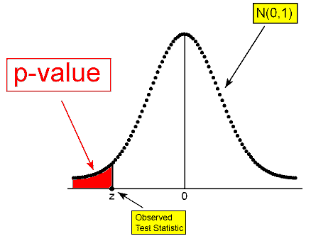
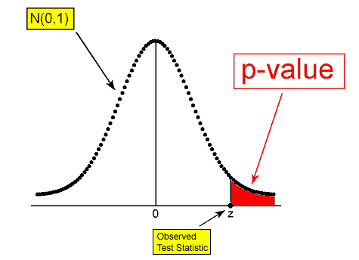
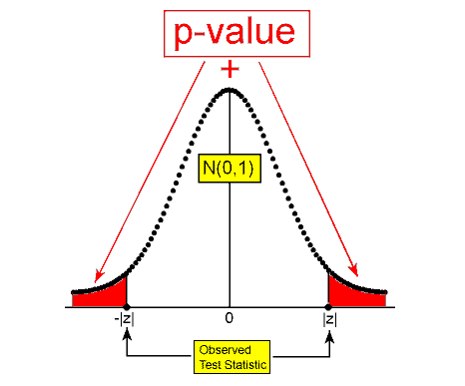

Slide 13
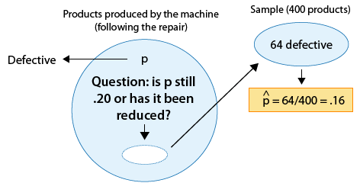
Example:
A machine is known to produce 20% defective products, and is therefore sent for repair. After the machine is repaired, 400 products produced by the machine are chosen at random and 64 of them are found to be defective. Do the data provide enough evidence that the proportion of defective products produced by the machine (p) has been reduced as a result of the repair?

Slide 14
The test statistic is a measure of how far the sample proportion pˆ is from the null value p0. In other words, since pˆ is what the data estimates p to be, the test statistic can be viewed as a measure of the "distance" between what the data tells us about p and what the null hypothesis claims p to be.
The parameter of interest is p, the proportion of defective products following the repair.
The data estimate p to be pˆ=.16pˆ=.16
The null hypothesis claims that p = .20
The data are therefore .04 (or 4 percentage points) below the null hypothesis with respect to what they each tell us about p.

Slide 15


1) When we take a random sample of size n from a population with population proportion p, the possible values of the sample proportion pˆ (when certain conditions are met) have approximately a normal distribution with:
* mean: p
* standard deviation:
2. The z-score of a normal value (a value that comes from a normal distribution) is:
and it represents how many standard deviations below or above the mean the value is. The test statistic for this test measures the difference between the sample proportion pˆ and the null value p0 by the z-score (standardized score) of the sample proportion pˆ, assuming that the null hypothesis is true (i.e., assuming that p=p0).

Slide 16
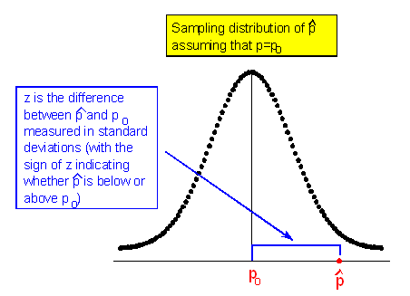
This is a model of how pˆs behave if we are drawing random samples from a population for which H₀ is true. (Notice the center of the sampling distribution is at p₀, which is the hypothesized proportion given in the null hypothesis (H₀: p = p₀.)

Slide 17
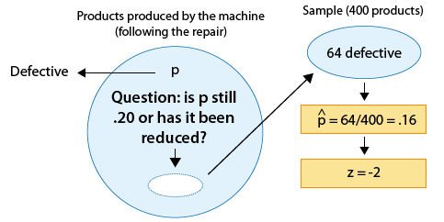
This z-score of −2 tells me that (assuming that H₀ is true) the sample proportion pˆ=.16 is 2 standard deviations below the null value (0.20).
This test statistic is a measure of evidence in the data against H₀. The larger the test statistic, the "further the data are from H₀" and therefore the more evidence the data provide against H₀.

Slide 18

Sampling
When we take a random sample of size n from a population with population proportion p, the possible values of the sample proportion (pˆ) (when certain conditions are met) have approximately a normal distribution with a mean of ... and a standard deviation of ....
These two conditions are:
1)The sample has to be random.
2)The conditions under which the sampling distribution of pˆ is normal are met. In other words:

Slide 19
Calculating p-value based on z-score
In reference to the example, The p-value is:
* The probability of observing a test statistic as small as -2 or smaller, assuming that H_{o} is true.
OR (recalling what the test statistic actually means in this case),
* The probability of observing a sample proportion that is 2 standard deviations or more below p0=.20, assuming that p0 is the true population proportion.
OR, more specifically,
* The probability of observing a sample proportion of .16 or lower in a random sample of size 400, when the true population proportion is p0=.20

Slide 20
Conclusions based on p-value
Based on the p-value, determine whether or not the results are significant (i.e., the data present enough evidence to reject H_{o}).
State your conclusions in the context of the problem. Let's go back to our problem and draw a conclusion
(Has the proportion of defective products been reduced from 0.20 as a result of the repair?)
->We found that the p-value for this test was 0.023.
->Since 0.023 is small (in particular, 0.023 < 0.05), the data provide enough evidence to reject H_{o} and conclude that as a result of the repair the proportion of defective products has been reduced to below 0.20. The following figure is the complete story of this example, and includes all the steps we went through, starting from stating the hypotheses and ending with our conclusions

Slide 21
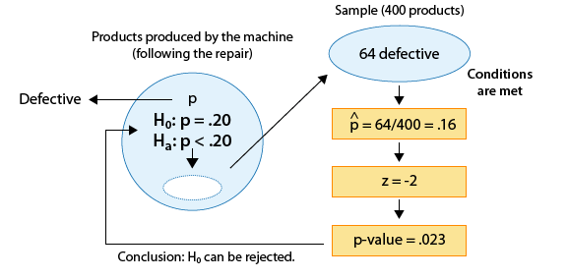

Slide 22
z-test with known S.D for the Population Mean
Example: The SAT is constructed so that scores in each portion have a national average of 500 and standard deviation of 100. The distribution is close to normal. The dean of students of Ross College suspects that in recent years the college attracts students who are more quantitatively inclined. A random sample of 4 students from a recent entering class at Ross College had an average math SAT (SAT-M) score of 550. Does this provide enough evidence for the dean to conclude that the mean SAT-M of all Ross college students is higher than the national mean of 500? Assume that the standard deviation of 100 applies also to all Ross College students.

Slide 23
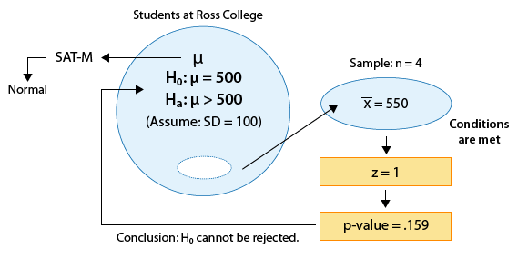

Slide 24
t-test for Population Mean with unknown S.D
* The null hypothesis has the form:
H0:μ=μ0, (where μ0 is the null value)
* The alternative hypothesis takes one of the following three forms (depending on the context):
Ha:μ<μ0 (one-sided)
Ha:μ>μ0 (one-sided)
Ha:μ≠μ0 (two-sided)
Assuming that the conditions are met, we calculate the sample mean x¯ and the sample standard deviation, S (which replaces σ), and summarize the data with a test statistic. As in the z-test, our test statistic will be the standardized score of x¯ assuming that μ=μ0 (H_{o} is true).

Slide 25

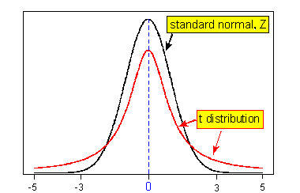
The test statistic for the t-test for the population mean is therefore:
->The t-test statistic in the test for the mean does not follow a standard normal distribution. Rather, it follows another bell-shaped distribution called the t distribution. t distribution has a larger spread than the normal distribution.

Slide 26
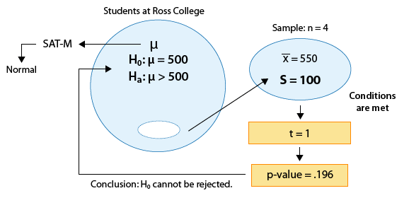
Using the previous example, assuming SD for population is unknown and SD for sample set is 100

Slide 27
Hypothesis Testing using R
1) Suppose 60% of citizens voted in last election. 85 out of 148 people in a telephone survey said that they voted in current election. At 0.05 significance level, can we reject the null hypothesis that the proportion of voters in the population is above 60% this year?
2)Suppose the food label on a cookie bag states that there is at most 2 grams of saturated fat in a single cookie. In a sample of 35 cookies, it is found that the mean amount of saturated fat per cookie is 2.1 grams. Assume that the population standard deviation is 0.25 grams. At .05 significance level, can we reject the claim on food label?
3) Suppose the food label on a cookie bag states that there is at most 2 grams of saturated fat in a single cookie. In a sample of 35 cookies, it is found that the mean amount of saturated fat per cookie is 2.1 grams. Assume that the sample standard deviation is 0.3 gram. At .05 significance level, can we reject the claim on food label?

Slide 28
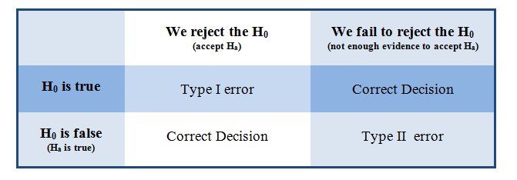
ERROR in Hypothesis Testing
Example: Suppose the manufacturer claims that the mean lifetime of a light bulb is more than 10,000 hours. Assume actual mean light bulb lifetime is 9,950 hours and the population standard deviation is 120 hours. At .05 significance level, what is the probability of having type II error for a sample size of 30 light bulb?

Slide 29
Reference:
https://oli.cmu.edu/jcourse/lms/students/syllabus.do?section=b2f85ba380020ca601f1e0bbe912d158
http://www.r-tutor.com/elementary-statistics/hypothesis-testing

